Slide 1
Section 3.5
Graphing Rational Functions

Slide 2
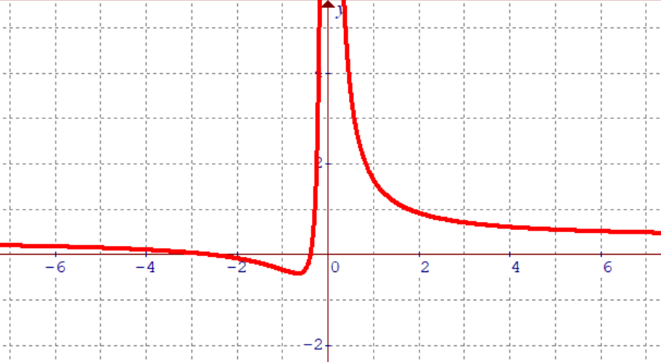
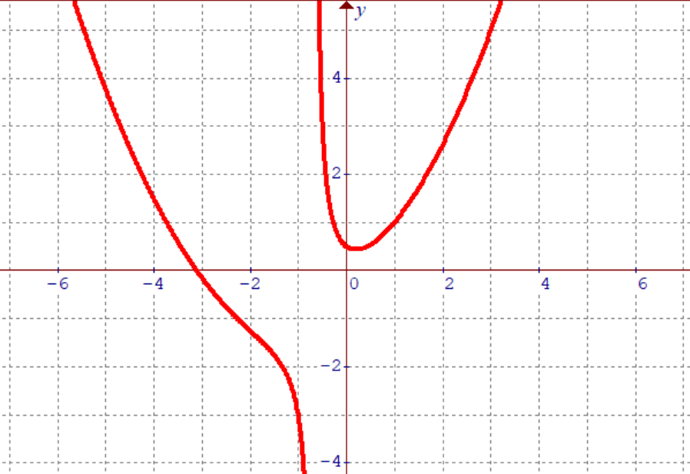
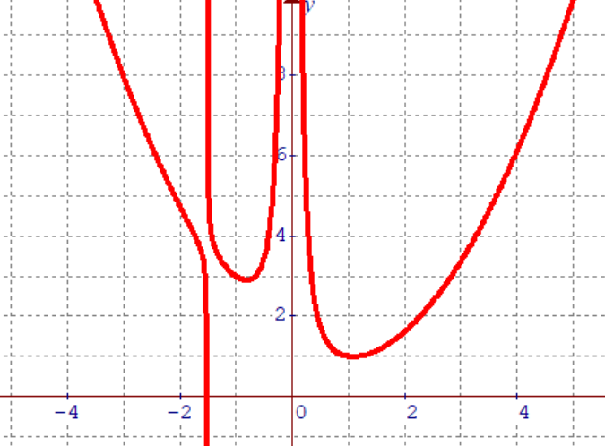
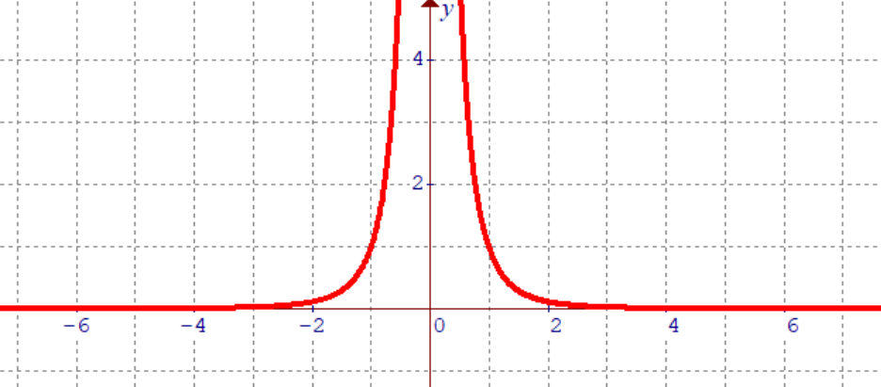
What is Taught in This lesson? Graphing Rational Functions
The purpose of this lesson is to learn how to graph rational functions
A rational function is a function with a polynomial dividing another polynomial
ie: The following are all variations of rational functions:
Quadratic over another quadratic
Cubic function over a linear function
Constant value over a quartic function
Quintic function over a cubic function

Slide 3
II) Long Division with Polynomials
The first step to graphing Rational functions is to be able use Long Division to find the Quotient and remainder when we divide the Numerator by the denominator!!!
Division Statement:

Slide 4
Practice: Divide Using Long Division & Write the Division Statement
Division Statement:

Slide 5
Note: Division statement:
When we have a rational function, the numerator is the dividend, and the denominator is the divisor
The Quotient and Remainder is used for graphing the Rational Function!
Division Statement:

Slide 6
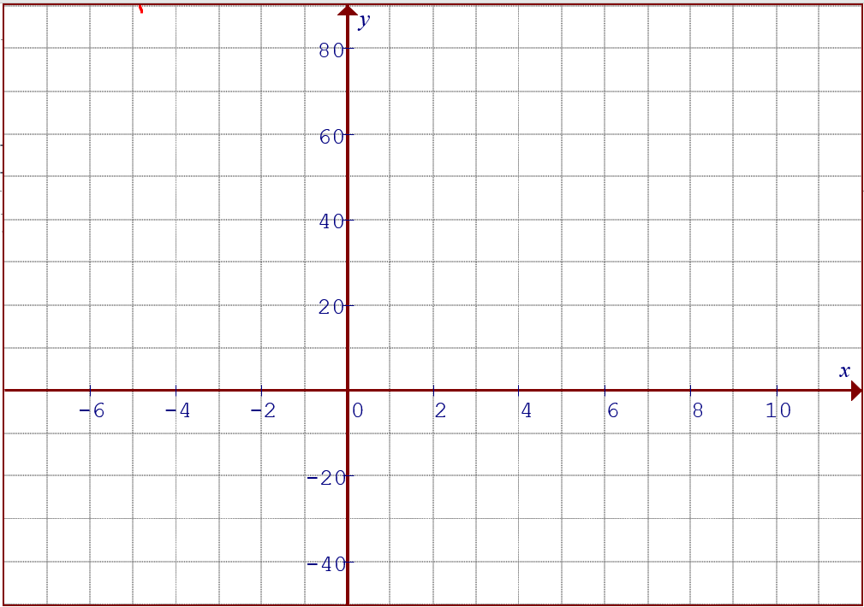
Components of a Rational Function:
Suppose we want to graph a rational function in the form:
The numerator is the Dividend
The denominator is the divisor, it’s where you will find the vertical asymptotes
The quotient will be the slanted asymptote
These two asymptotes will be used
to approximate graphically how the rational function will look like
The remainder is used to find where the function will “cross” the slanted asymptote

Slide 7
Steps For Graphing Rational Functions:
Step 1. Find the NPV’s in the denominator → Vertical Asymptotes
  Factor the Denominator, make it equal to zero and solve for “x” (Denominator can never be zero) → these “x: values become VA
2. Use Long Division and Divide the Dividend by the Divisor
Get the Quotient → Quotient will become the Horizontal/Slanted Asymptotes
If the quotient is a linear function, then the slanted asymptote will be a straight line
If the quotient is a Quadratic function, then the slanted asymptote will be a parabola
3. Use the asymptotes to approximate the patterns of the graph
NOTE: The graph gravitates/ “follows” the asymptotes [Ex#1]
4. Find the Remainder
IF the Remainder has a variable, these will be points where the graph will “CROSS OVER” the slanted asymptotes {Ex#3}
If there are no variables in the remainder, the graph will never cross the asymptotes
If the Remainder is zero, then the Quotient is substituted as the graph!
5. Create an inequality to Compare which is above: Rational Function or Quotient?
  Pick points in each domain, compare which has greater value: Function or the Quotient
  This is used to determine which side of the slanted asymptote the graph is on…..

Slide 8
Ex1: Given the following function, a) Find the Vertical Asymptote & Slanted Asymptote b) Use the Asymptote to graph the function
4. On the left side of the V.A, the graph can
be only “Above” or “Below” the Slanted Asymp
Find the VA (Denominator)
y
60
2. Long Division: Quotient: (Slanted Asymptote)
40
20
x
-8
-4
0
4
8
12
16
-20
3. Since there are no “x” in the remainder,
the graph does not intersect the asymptotes
-40

Slide 9
Things to Remember:
The Asymptotes dictate the shape of the rational functions!!!
  The graph of the rational function “follows” the asymptotes
2. There are two types of Asymptotes:
Vertical Asymptotes (NPV) and Slanted Asymptotes (Quotient)
The graph will NEVER cross a V.A.
The graph will Cross the Slated Asymptote depending on the remainder!!!
3. To decide whether if the graph is “ABOVE” or “BELOW” the slanted asymptote, compare the inequality between “FUNCTION” vs “Quotient”
PICK a point on that side of the VA
If the Function is bigger, then the graph is “ABOVE” the slanted asymptote
If the Quotient is bigger, then the graph is “BELOW” the slanted Asymptote
4. Find the Remainder, the remainder will tell us if our rational function crosses the slanted asymptotes

Slide 10
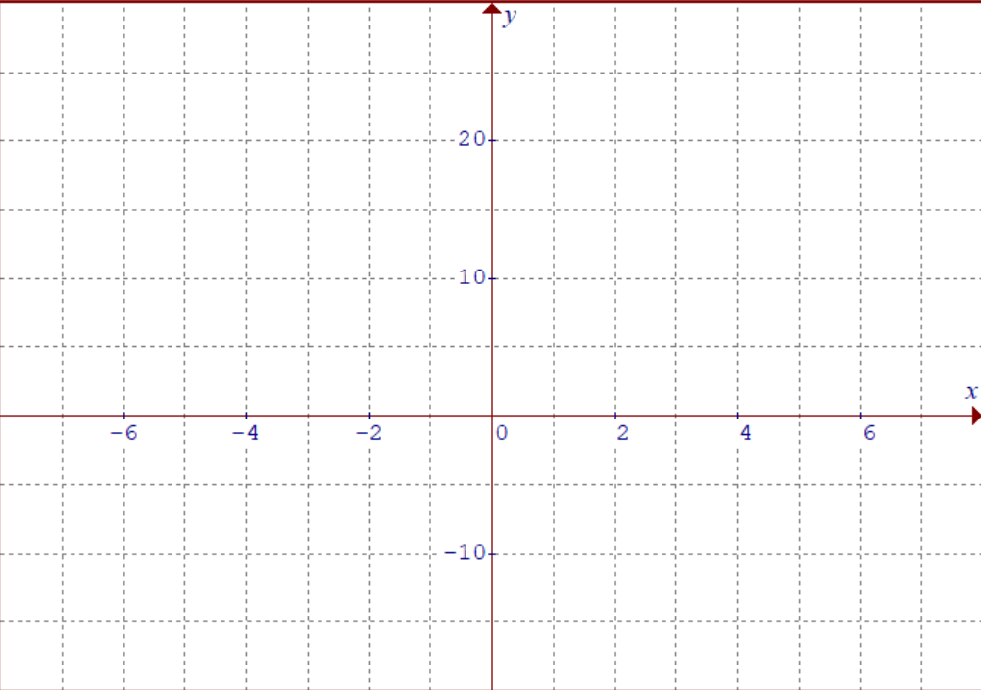
Ex: 2 Graph the Rational Function
i) Find all the NPV’s and get the domain and range
Simplify the equation
Find the VA (Denominator)
3. Quotient (Slanted Asym)
The remainder is NOT zero, that mean equation will NOT cancel out
The remainder does not contain any variables, so the graph will not intersect the asymptotes….
4. X-intercepts (numerator)

Slide 11
y
80
60
40
20
x
-6
-4
-2
0
2
4
6
-20

Slide 12
y
80
60
40
20
0
x
-6
-4
-2
0
2
4
6

Slide 13
What does the Remainder Do??
In general, we can use the remainder to determine whether if the rational function will cross over the slanted or horizontal asymptotes
If the rational function intersects the slanted asymptote, then the function and Quotient MUST be equal
Therefore, any value of “x” that make the remainder equal to zero is where the graph and the slanted asymptotes intersect each other…..

Slide 14
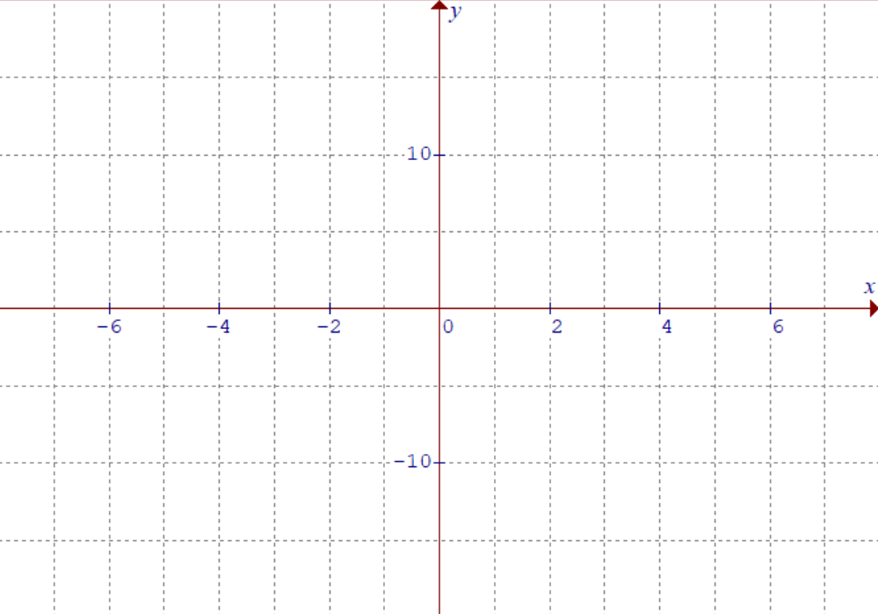
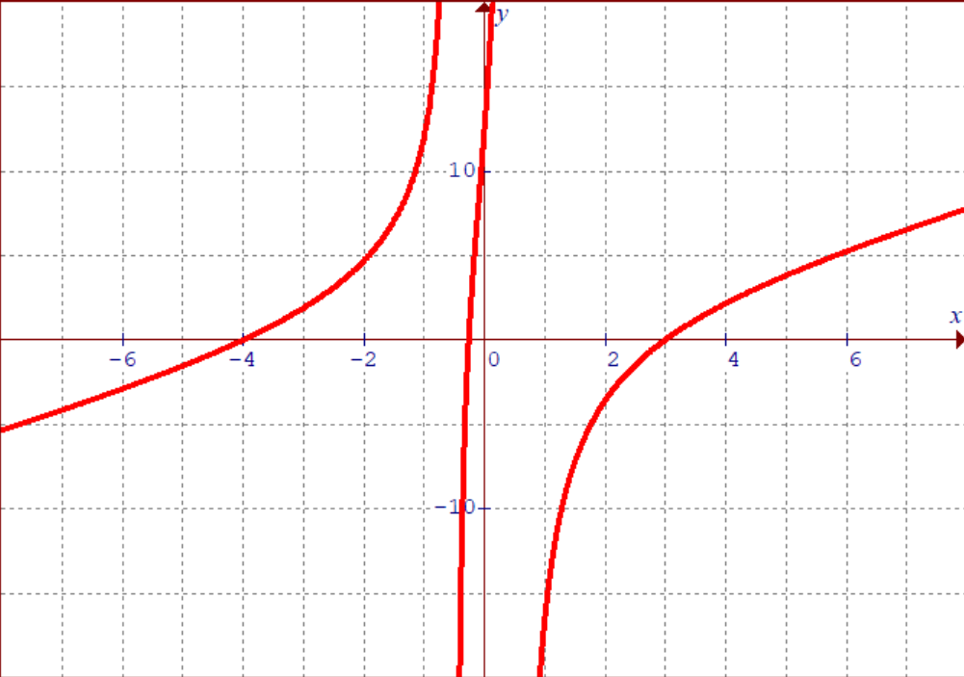
Ex 3: Graph the Rational Function
i) Find all the NPV’s and get the domain and range
Simplify the equation
Find the VA (Denominator)
At x = -0.2337… this is where our Rational function will intersect the slanted asymptote
3. Quotient (Slanted Asym)
4. Remainder:
4. X-intercepts (numerator)

Slide 15
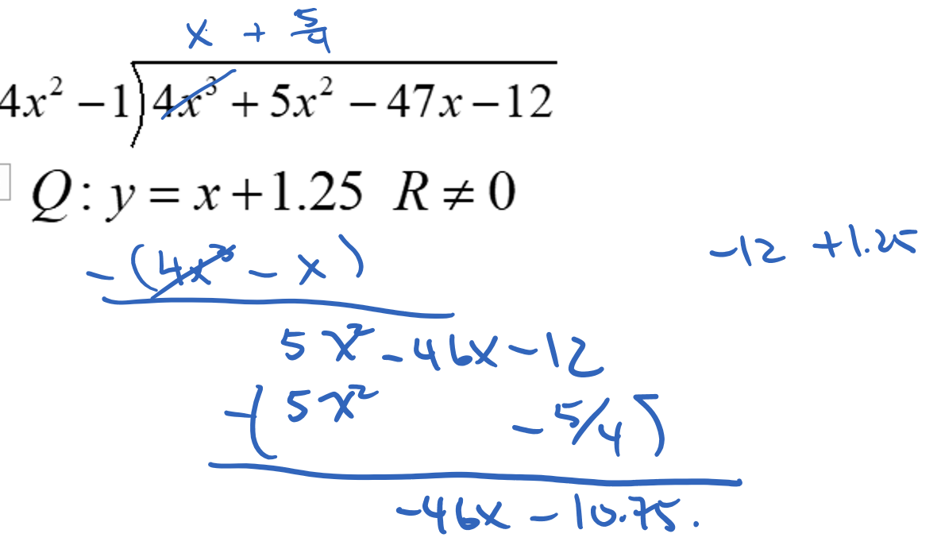

Slide 16
y
50
0
x
-6
-4
-2
0
2
4
6

Slide 17
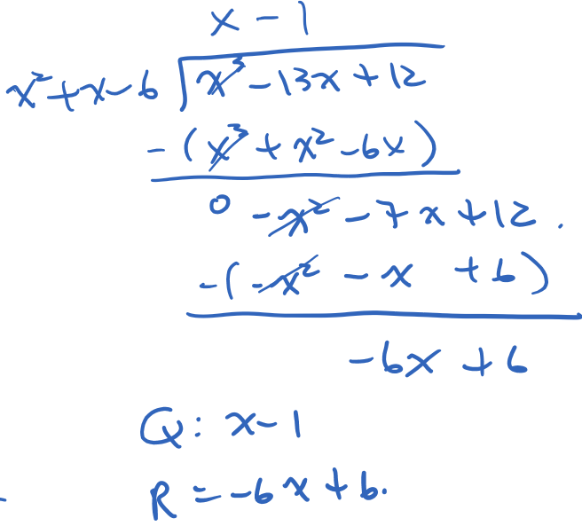
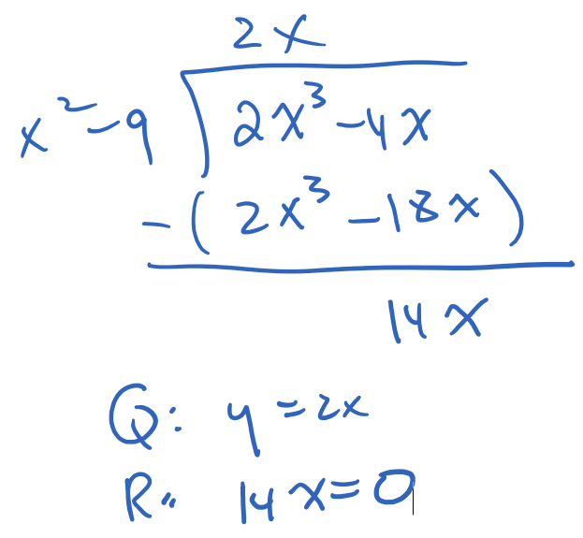
For each of the following rational functions, find the following:
i) Find the Vertical Asymptotes ii) Find the slanted Asymptotes
iii) Find the remainder iv) Find the X-intercepts
1. Find the VA (Denominator)
1. Find the VA (Denominator)
2. Quotient:
2. Quotient:
3. Remainder
3. Remainder
4. x-intercepts:
4. x-intercepts:

Slide 18
Ex4: Graph the following equations using the Asymptotes, x-intercepts and remainders:
y
1. Find the VA (Denominator)
10
2. Quotient:
3. Remainder
0
x
At x=1 is where the remainder is equal to zero. So this is where it crosses the slanted asymptote!
-6
-4
-2
0
2
4
6
-10
4. x-intercepts:

Slide 19
Ex5: Graph the following equations using the Asymptotes, x-intercepts and remainders:
y
1. Find the VA (Denominator)
20
2. Quotient:
x
0
3. Remainder
-6
-4
-2
0
2
4
6
-20
4. x-intercepts:

Slide 20
Things to Keep in Mind:
1. Vertical Asymptotes are found in the denominator (NPV’s). The graph will “NEVER” cross over a vertical asymptote
2. The quotient is the slanted asymptote: y = Quotient
  Note: If the remainder is zero [top divides the bottom], then the quotient becomes the substitute for the graph, with the addition of the “Hollow” dot at the NPV {Ex#7}
3. the remainder tells you where the rational function “crosses over” the slanted asymptote
  Make the remainder equal to zero and solve for ‘x”
  If the remainder is a linear function, then it will “cross over” at only ONE point
  If the remainder is “quadratic” then it will “cross over” at MOST two points
4. Any factor that you cancel out (Top with Bottom) will result in a hollow dot
{Ex#6}

Slide 21
Practice: Graph the following function
1. Find the VA (Denominator)
2. Find the HA (Long Division)
Since (x+4) was cancelled out, when x = -4, there will be a “HOLLOW” dot on your graph!

Slide 22
y
y
The function can be simplified and reduced!
5
5
x
x
-9
-9
-8
-8
-7
-7
-6
-6
-5
-5
-4
-4
-3
-3
-2
-2
-1
-1
0
0
1
1
2
2
3
3
4
4
5
5
-5
The equation can be simplified to a straight line
-5
-10
At the asymptote, you get a “HOLLOW DOT” because you can’t have a value for “x” at that point!
-10

Slide 23
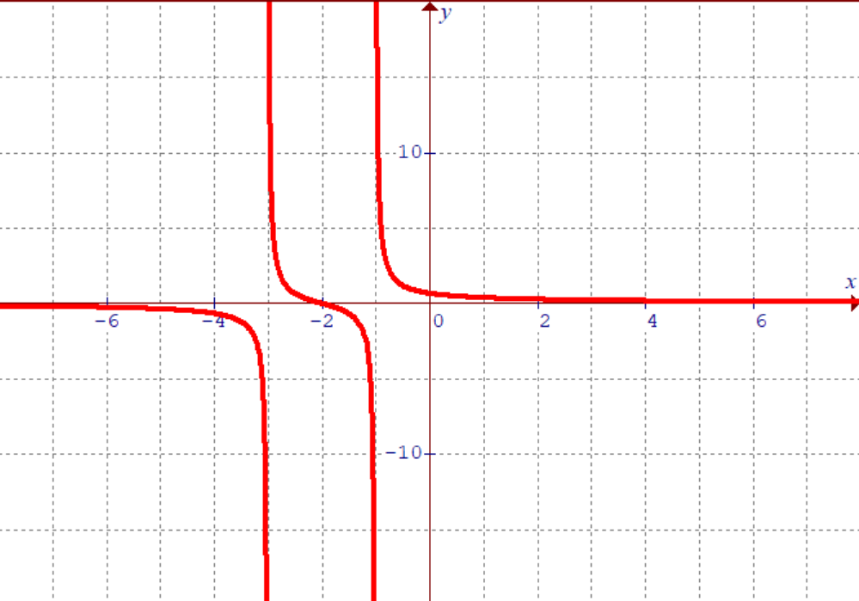
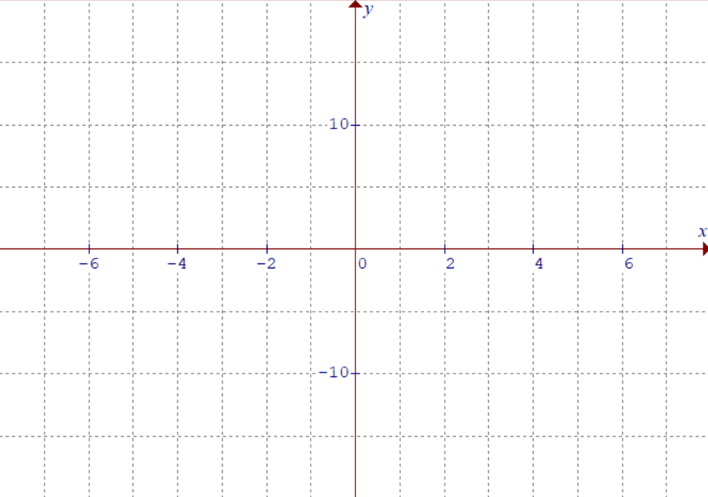
Ex6: Graph the Rational Function
i) Find all the NPV’s and get the domain and range
Simplify the equation:
Since we cancelled out x-3, the graph will have a hollow dot at x=3
Since we cancelled out x-3, the graph will have a hollow dot at x=3
2. Find the VA (Denominator)
3. Quotient (Slanted Asym)
4. X-intercepts (numerator)

Slide 24
Example 7: Graph the following function
1. Find the VA (Denominator)
2. Find the HA (Long Division)

Slide 25
Graph the following functions. Find all the asymptotes, quotient, and remainder. State the domain and range:

Slide 26
Practice: Graph the following function
1. Find the VA (Denominator)
2. Find the HA (Long Division)

Slide 27
y
y
8
8
6
6
4
4
2
2
x
x
-8
-6
-4
-2
0
2
4
6
8
-8
-6
-4
-2
0
2
4
6
8
-2
-2
-4
-4
-6
-6
-8
-8

Slide 28
Practice: Graph the following function
1. Find the VA (Denominator)
2. Find the HA (Long Division)

Slide 29
y
y
10
10
5
5
x
x
-5
-4
-3
-2
-1
0
1
2
3
4
5
-5
-4
-3
-2
-1
0
1
2
3
4
5
-5
-5
-10
-10

Slide 30
y
y
10
10
5
5
x
x
-7
-7
-6
-6
-5
-5
-4
-4
-3
-3
-2
-2
-1
-1
0
0
1
1
2
2
3
3
4
4
5
5
6
6
7
7
-5
-5
-10
-10

Slide 31
Practice: Graph the following function
1. Find the VA (Denominator)
2. Find the HA (Long Division)

Slide 32
y
y
2
2
1
1
x
x
-8
-8
-6
-6
-4
-4
-2
-2
0
0
2
2
4
4
6
6
8
8
-1
-1
-2
-2

Slide 33
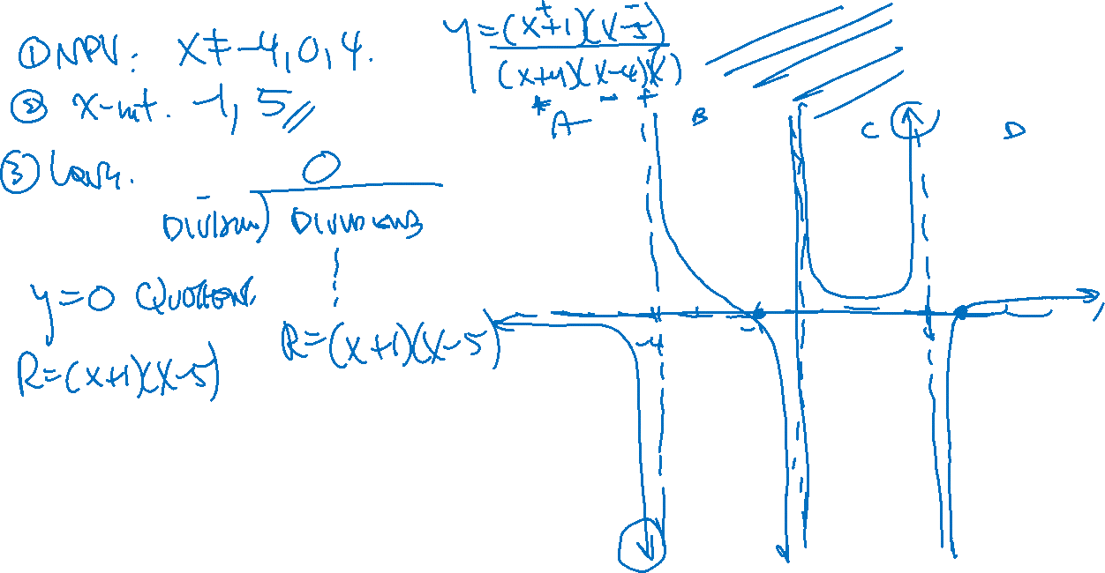

Slide 34
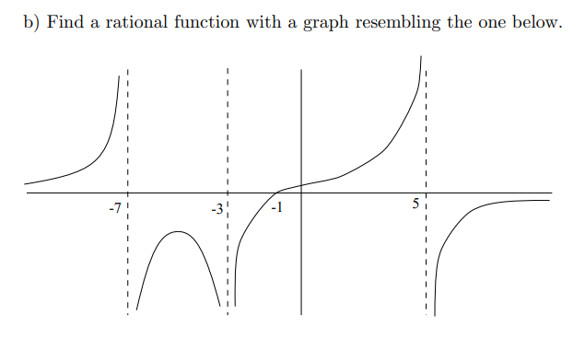

Slide 35
Peng’s Method: How to Find the Max/Min
The rational function is in the form of
We have a second equation in the form of
So we solve this equation for “k” so that it will have only one solution
Use the Discriminant to restrict “k” so that you only have one solution
So the range for function would be:
y
60
If “k” was greater than the max or less than the min, you would have two solutions
40
If “k” was on the max or the min, you would have only ONE solution
20
If “k” was in between the max and min, you would have no solutions
x
-8
-4
0
4
8
12
16
-20
-40

Slide 36
Practice: Find the range

